Slide 1
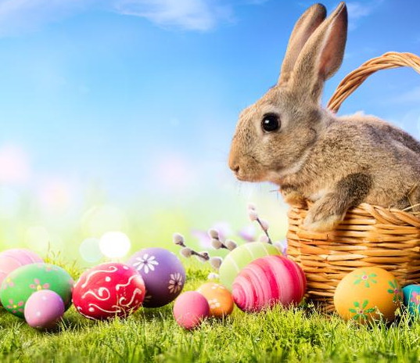
EASTER

Slide 2
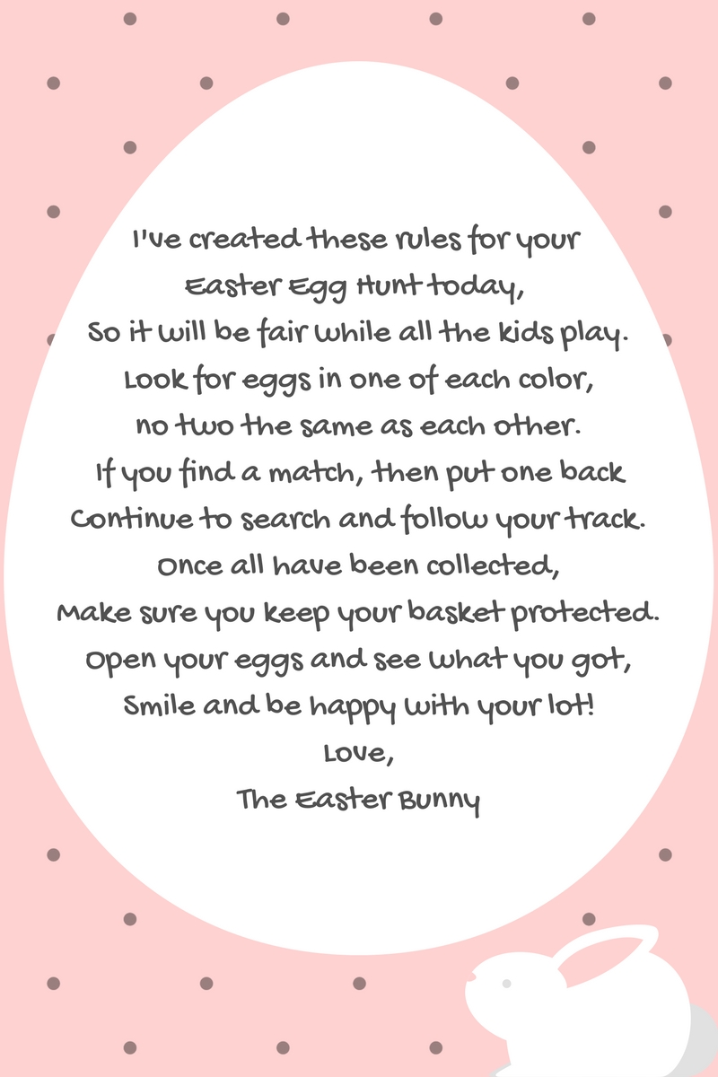
EGG HUNT
egg hunt is a game during which decorated eggs or Easter eggs are hidden for children to find. Real hard-boiled eggs, which are typically dyed or painted, artificial eggs made of plastic filled with chocolate or candies, or foil-wrapped egg-shaped chocolates of various sizes are hidden in various places. The game is often played outdoors, but can also be played indoors. The children typically collect the eggs in a basket.
When the hunt is over, prizes may be given out for various achievements, such as the largest number of eggs collected, for the largest or smallest egg, for the most eggs of a specific color, consolation prizes or booby prizes.Real eggs may further be used in egg tapping contests.

Slide 3
HISTORY
The egg was a symbol of the rebirth of the earth in pre-Christian celebrations of spring. However, the Easter egg itself was defined by early Christians as an Easter symbol of the resurrection of Jesus: the egg symbol was likened to the tomb from which Christ arose.
At least since the 17th century the idea of the Easter Bunny to bring the Easter eggs has been known.

Slide 4
EGG ROLLING
Egg rolling, or an Easter egg roll is a traditional game played with eggs at Easter. Different nations have different versions of the game, usually played with hard-boiled, decorated eggs.
Egg rolling has been a tradition at Avenham Park for hundreds of years, but in recent years chocolate eggs have been used.
This tradition, along with others, such as what had become the Easter Bunny, were taken to the New World by European settlers.

Slide 5
EGG TAPPING
Egg tapping, or also known as egg fight, egg knocking, egg pacqueing, egg boxing, egg picking, egg chucking.
The rule of the game is simple. One holds a hard-boiled egg and taps the egg of another participant with one's own egg intending to break the other's, without breaking one's own.
In England, the game is played between pairs of competitors who repeatedly knock the pointed ends of their eggs together until one of the eggs cracks; the overall winner is the one whose egg succeeds in breaking the greatest number of other eggs. The world egg-jarping championships have been held each Easter Sunday.

