Slide 1
UNITED STATES OF AMERICA (USA)
Dora ćurić-jazvić

Slide 2
States
Alabama,alaska,arizona,arkansas
California,colorado,connecticut,delaware,florida,georgia
Hawaii,idaho,illinois,indiana,iowa,kansas,kentucky,lousiana,maine
Maryland,massachusetts,michigan,minessota,mississippi,missouri
Montana,nebraska,nevada,hampshire,new jersey,new mexico,new york,north carolina,north dakota,ohio,oklahoma,oregon,pennsylvania,rhode island,south carolina,south dakota,tennessee,texas,utah,vermont,virginia,washington,west virginia,wisconsin,wyoming

Slide 3
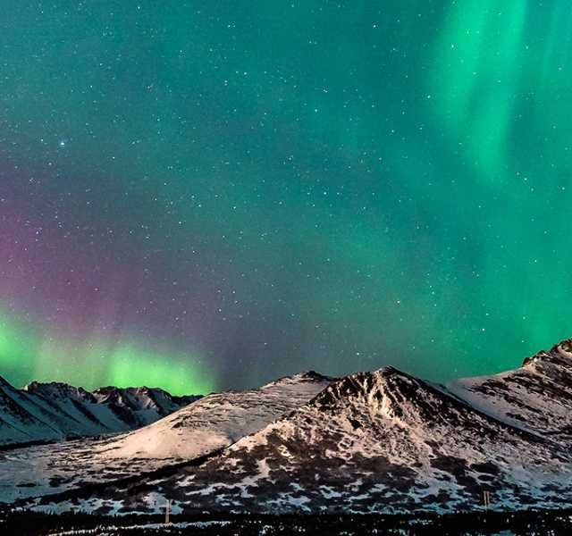
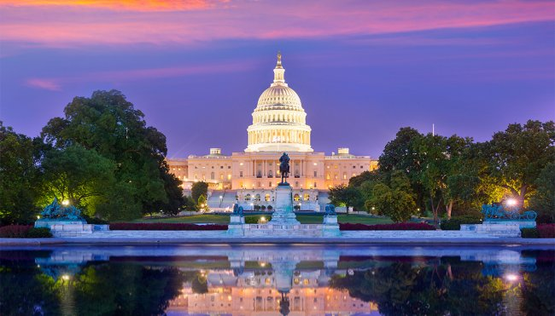
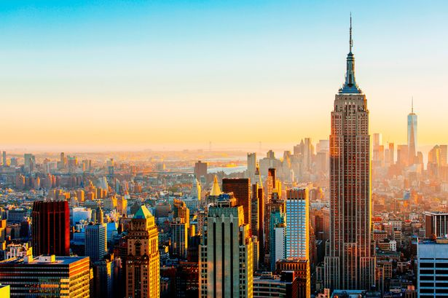
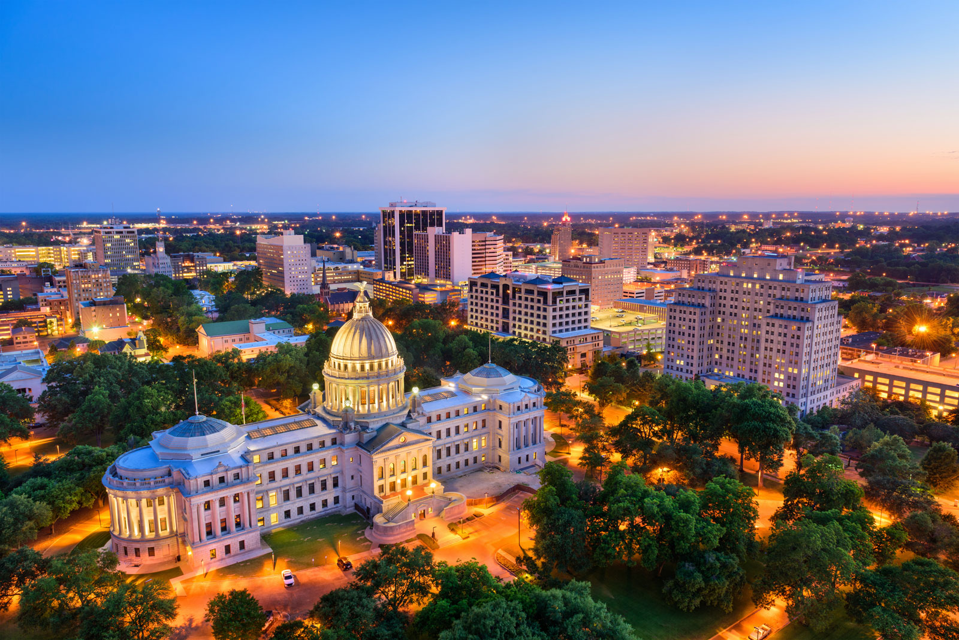
The united states of america is a country.
On the american flag there are thirteen stripes and fifty stars.
The american president lives in the white house.
The name of the big river which flows trough the usa is the mississippi.
The capita of the Usa is washington d.c.

Slide 4
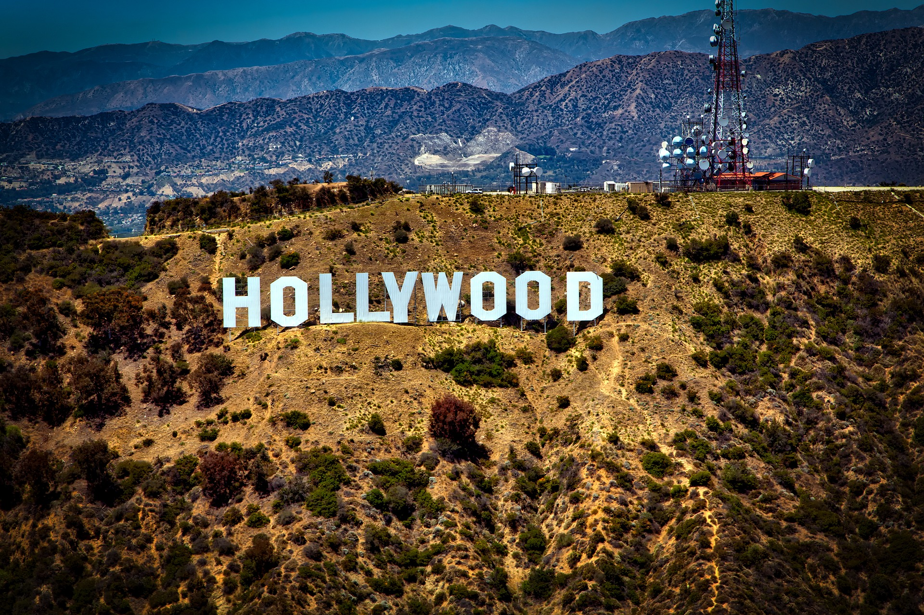
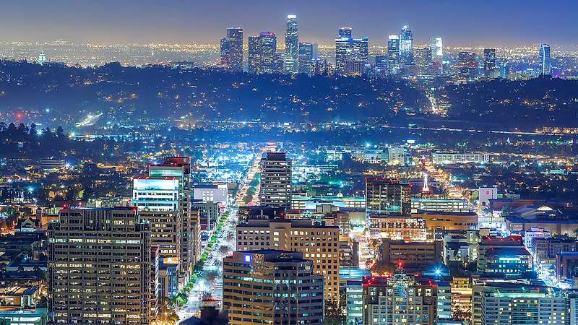
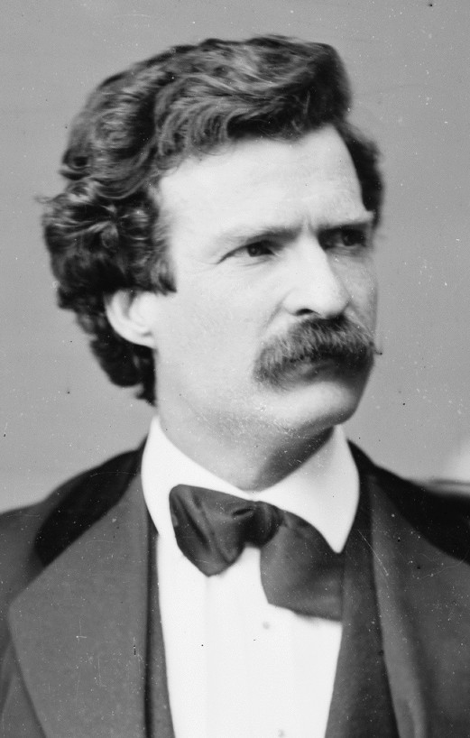
The big apple is a nickname for new york city.
In hollywood there are a lot of actors.
The part of the usa that you can see in westerns is called the wild west.
L.a is short for los angeles.
Mark twain wrote the adventures of tom sawyer.

Slide 5
Thanks for watching!!!

